Slide 1
Introduction to Health Science
The Endocrine System

Slide 2
General Functions of the Endocrine System
The endocrine system is made up of glands that release their products (hormones) directly into the bloodstream.
Hormones are for communication
Slower and longer-lasting than nerve impulses
Hormones help to regulate important processes throughout the body.
Growth
Development and maturation
Chemicals
Metabolism

Slide 3
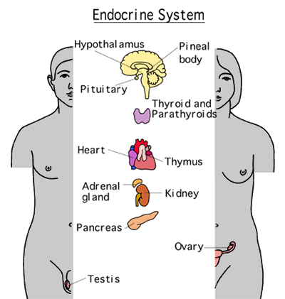

Slide 4
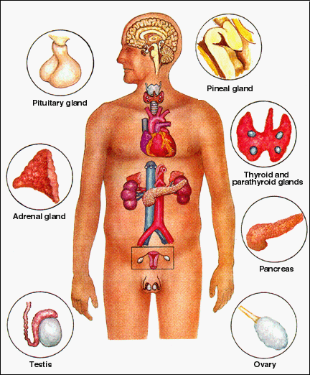

Slide 5
Pituitary Gland
Small pea-shaped gland hanging from the underside of the brain.
The “Master Gland”: produces many of the body’s hormones

Slide 7
Hormones Produced by the Pituitary Gland
Growth Hormone (GH)
Stimulates the production of proteins and growth in body cells.
Made by anterior pituitary
Oxytocin
Stimulates uterine contractions during childbirth and helps release milk for nursing mothers
Stored in the posterior pituitary gland

Slide 8
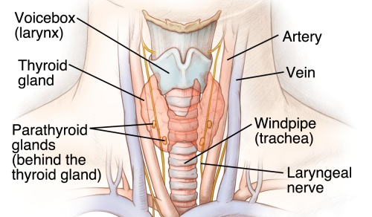
Thyroid Gland
Located in the neck just below the voice box (larynx) and around the upper part of the trachea
Bow-tie shaped

Slide 9
Hormones of the Thyroid Gland
Thyroxine
Regulates the metabolic rate of most cells of the body
Conversion of food to energy

Slide 10
Pancreas
Located behind the stomach
Fish shaped
Also part of the digestive system

Slide 11
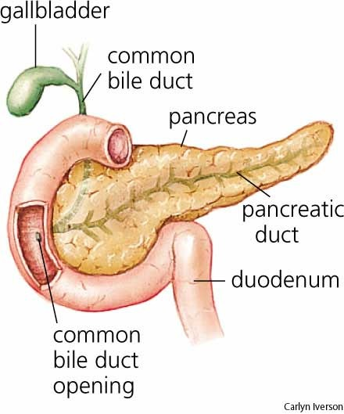
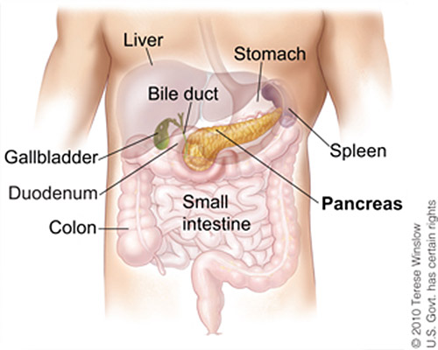

Slide 12
Hormones Produced by the Pancreas
Insulin
Released when blood sugar (glucose) is high
Causes body cells to uptake glucose
Glucose is used for fuel
Liver and muscle cells convert glucose to glycogen
Cells convert excess glucose to fat
Glucagon
Released when blood sugar (glucose) is low
Causes the break down the glycogen in the liver and the muscles
Glucose is released back into the blood

Slide 13
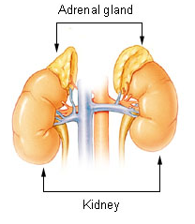
Adrenal Glands
Triangular-shaped glands that sit on top of each kidney
2

Slide 14
Hormones of the Adrenal Glands
Cortisol
Helps control the rate of metabolism of carbohydrates, fats, and proteins.
Released during times of continuous stress.
Suppresses the action of the white blood cells
More susceptible to illness.

Slide 15
Hormones of the Adrenal Glands
Adrenaline (epinephrine)
Helps to regulate the stress (sympathetic) response
“Fight or flight.”
Makes up 80% of the secretions from the adrenal medulla

Slide 16
The Sympathetic Response
increased heart rate
increased breathing rate
increased blood flow to the muscles
increased blood pressure
increase in the depth of breathing increasing oxygen intake
release of extra glucose for more energy
sweaty hands and palms

Slide 17
Noradrenaline
Noradrenaline (norepinephrine)
Helps to regulate the stress (sympathetic) response
“Fight or Flight.”
Makes up 20% of the secretions from the adrenal medulla

Slide 18
Diseases and Disorders of the Endocrine System
Type I Diabetes Mellitus
Type II Diabetes Mellitus
Gigantism
Dwarfism
Hypothyroidism
Hyperthyroidism

Slide 19
Type I Diabetes Mellitus
Pancreas does not produce enough insulin to regulate blood sugar.
Glucose increases in the bloodstream instead of going into the body cells
Lifelong disease
Requires insulin injections

Slide 20
Type II Diabetes Mellitus
Pancreas produces insulin but the body does not respond
Glucose increases in the bloodstream instead of going into the body cells
Most common form of diabetes.
Treated by better diet and exercise

Slide 21
Gigantism
Gigantism is due to a hypersecretion of growth hormone during childhood resulting in a person who grows to a very large size.
May be caused by a non-cancerous tumor of the pituitary gland.

Slide 22
Dwarfism
Dwarfism is due to a hyposecretion or underproduction of the growth hormone during childhood resulting in a small person of normal proportions.
Condition may be present at birth or develop as a result of brain injury, tumor, or other medical condition.

Slide 23
Hypothyroidism
Hypothyroidism occurs when the thyroid gland fails to produce enough thyroid hormone.
May result in mental retardation and stunted growth.
Cretinism (early onset, infants & young children).
Myxedema (later onset).

Slide 24
Hyperthyroidism
Hyperthyroidism occurs when the thyroid gland produces too much of the thyroid hormones.
Symptoms include weight loss, increased appetite, nervousness, restlessness, increased sweating and protruding eyes.
Treatment may include removal of the thyroid with radiation or surgery and replacement of thyroid hormones.

